Slide 1
PyCon DE & PyData Berlin 2022
(Serious) Time for Time Series
It’s time to take time series seriously!
Notes:
Welcome

Slide 2
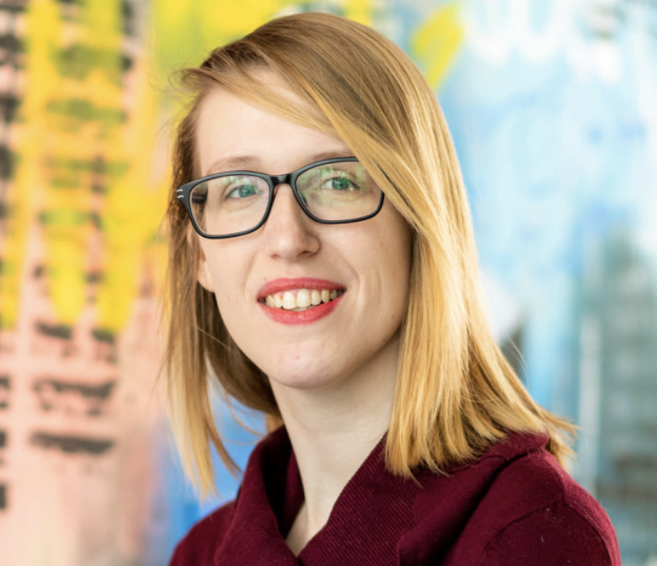
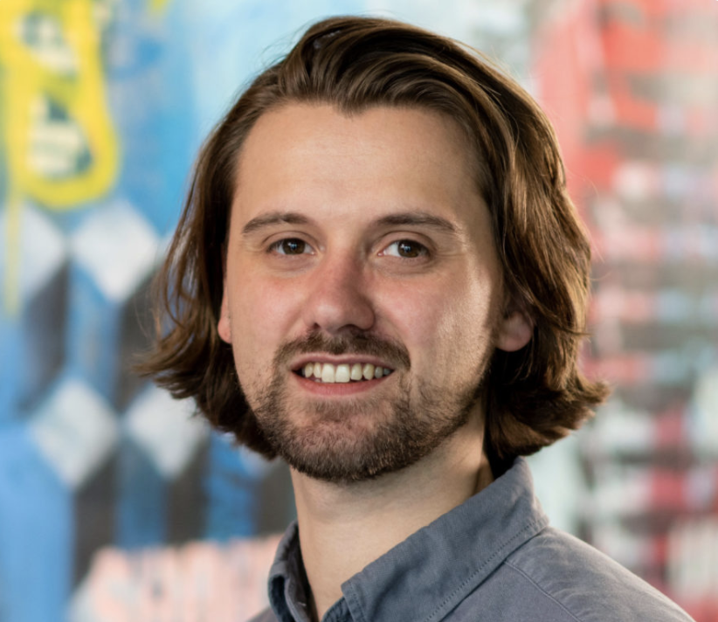
About us
Marysia Winkels
James Hayward
Data Science Educator
GoDataDriven
Data Science Educator
GoDataDriven
Notes:
Introduce ourselves: Background and how we ended up at GoDataDriven.

Slide 3
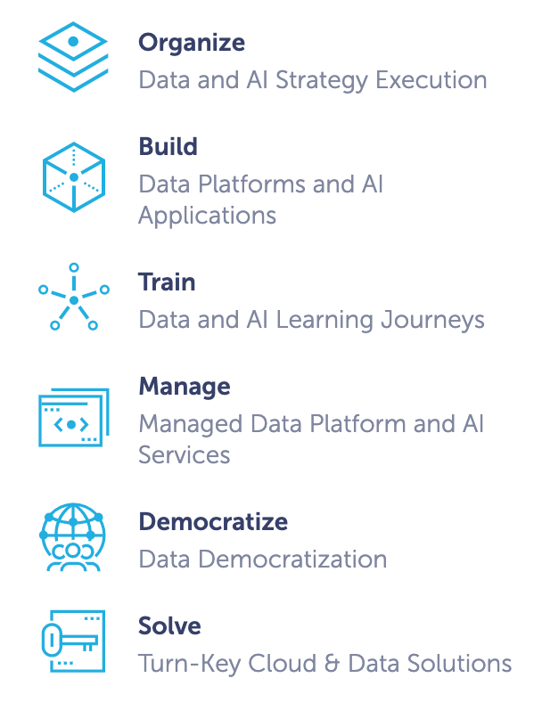
GoDataDriven
Notes:
As said, we both work for GoDataDriven, which is a Dutch Data Science consultancy based in Amsterdam.

Slide 4
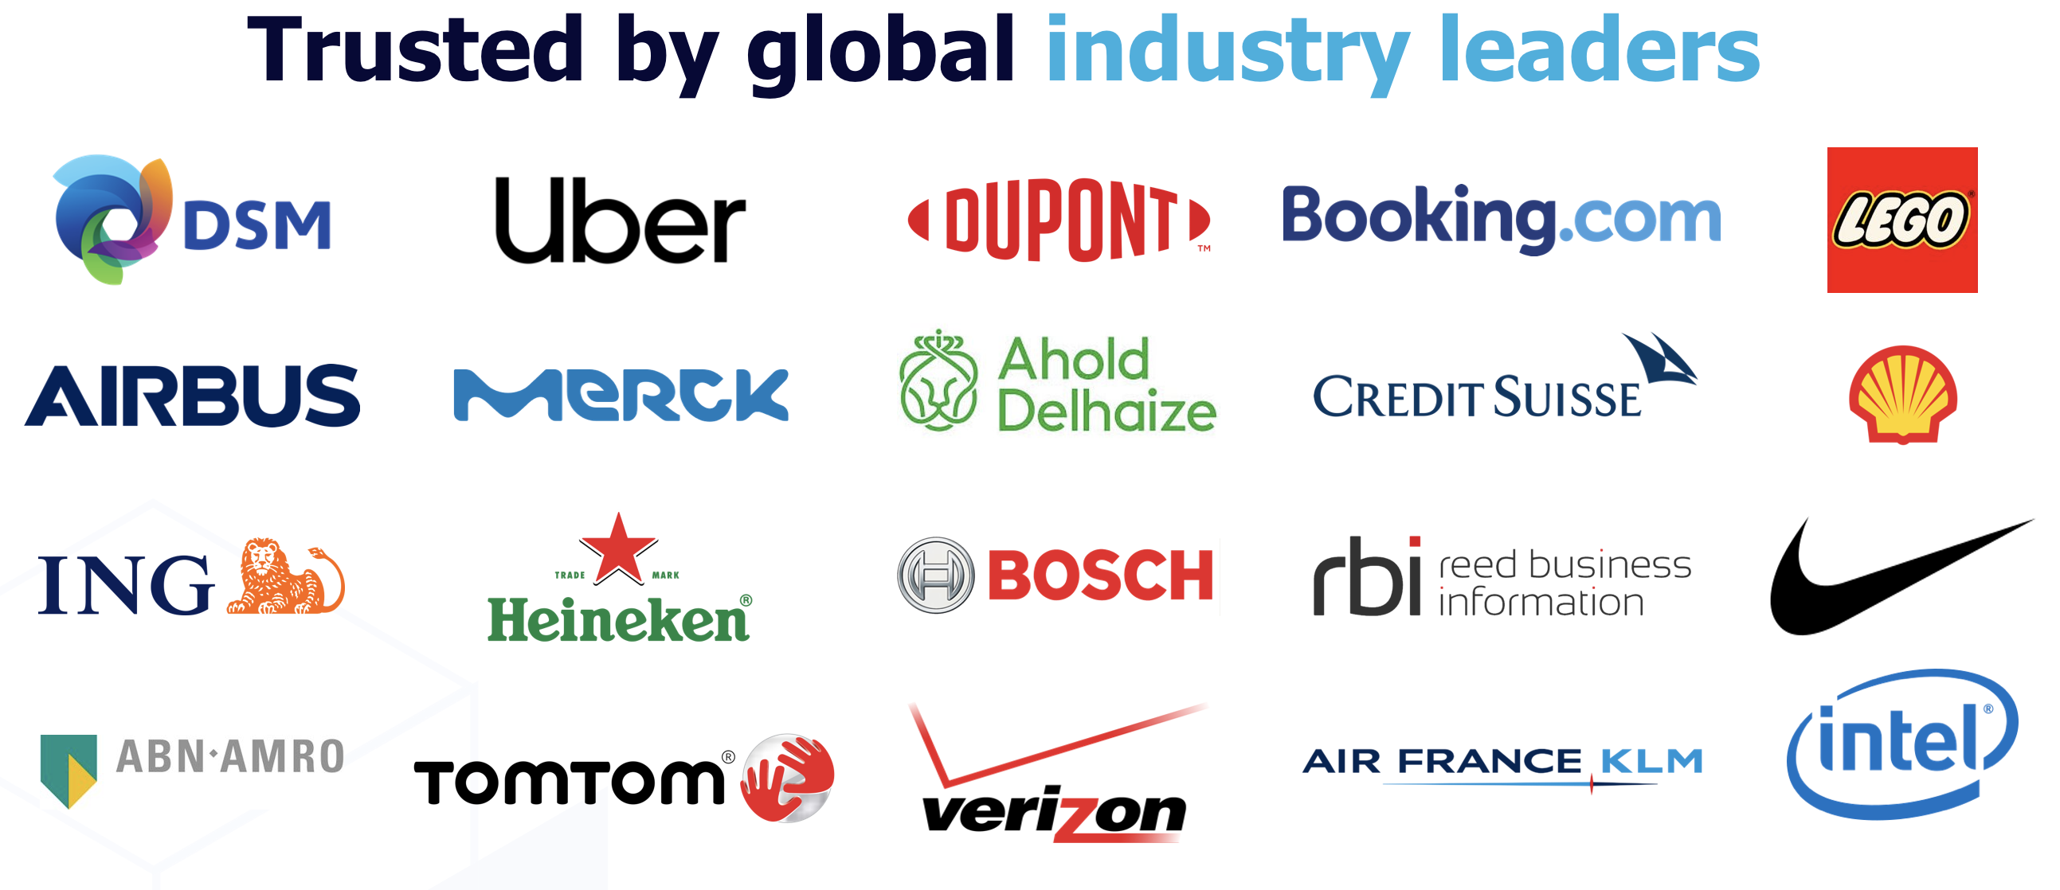
Notes:
GoDataDriven has been helping businesses become data driven and get value from their data since 2009.
In addition to consultancy projects, one way we do that is through our public and in-company trainings.

Slide 5
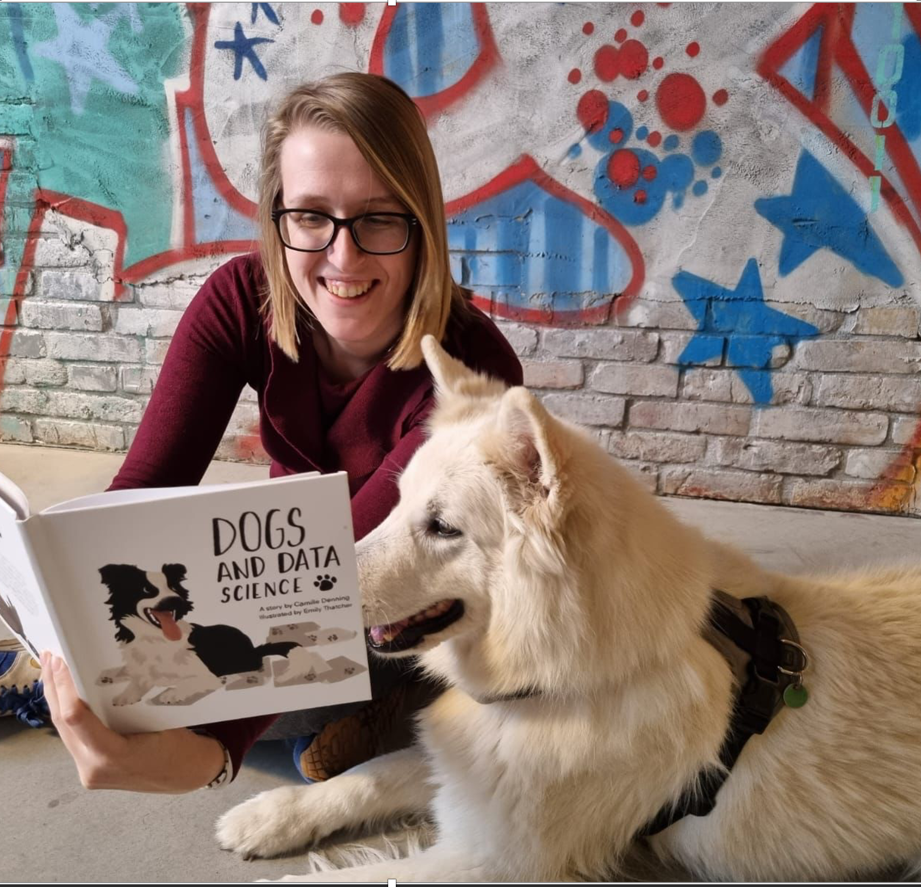
GoDataDriven Academy
A variety of courses
Data Science with Python (introductory & advanced)
Deep Learning
Data Visualisation & Storytelling
Analytics Translation
Time Series
Machine Learning Explainability
Notes:
We’re Data Science Educators!

Slide 6
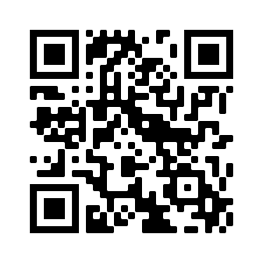
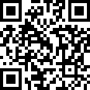
About you!
Join us at PollEverywhere
gdd.li/poll-berlin

Slide 7
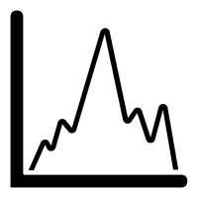
Agenda
Tutorial
Introduction
Time series analysis with Pandas
Seasonality modeling
Challenge
Closing remarks
10 minute break halfway through!
Notes:
Data with time
What a time series is

Slide 8


Workshop content
Things we will cover
What this workshop is not about
Introduction to Time Series Analysis with Pandas
Modelling Time Series data & Seasonality
Deep Learning
Prophet (or other Time Series libraries)
Notes:
Deep Learning - this is an introduction to time series analysis and seasonality
Prophet – Library from facebook, deals with seasonality well but we want to explain they why today
ARIMA – better for short-term forecasting, today we will be focussing on data which has seasonality- this istypically more relevant to business cases (whereas ARIMA model was developed with the stock market in mind)

Slide 9


Material
gdd.li/time-series-github
gdd.li/time-series-binder

Slide 10
Time Series Analysis with Pandas
Notes:
https://create.kahoot.it/details/87909336-f11a-422d-9dbe-9d93f497b768

Slide 11
Seasonality Modeling

Slide 12
PyCon DE & PyData Berlin 2022
(Serious) Time for Time Series
It’s time to take time series seriously!
Notes:
Thank you – session has come to an end

Slide 13
Workshop Summary
Introduction to Time Series Analysis
Seasonality Modelling
Timestamps
Time-based aggregations
Creating time-based features
Smoothing Time Series data
Time Series decomposition
Modelling Time Series data
Engineering seasonal features
Notes:
Summarise what we’ve covered

Slide 14
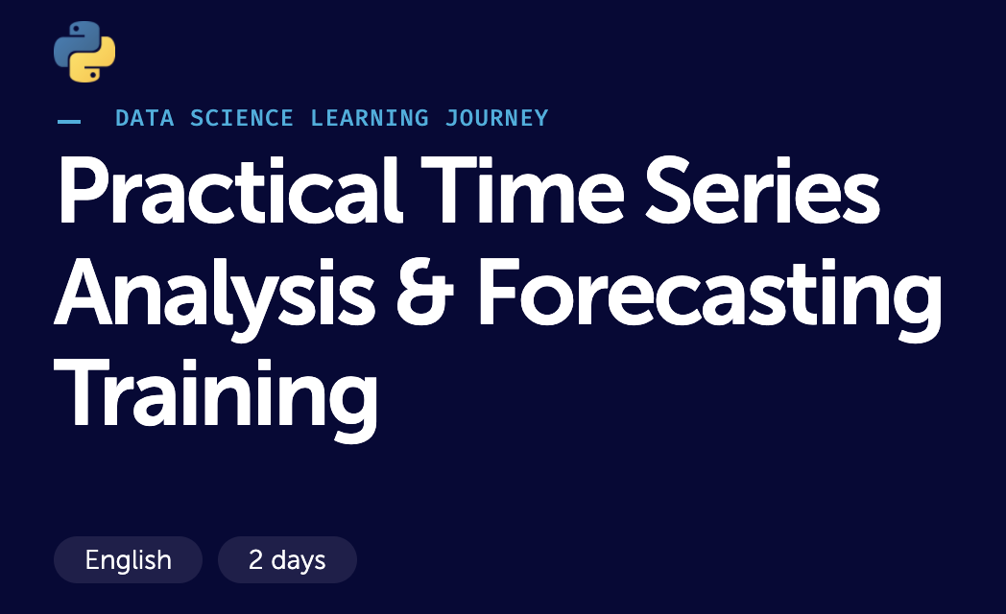
gdd.li/time-series-training
GoDataDriven Academy
A variety of courses
Data Science with Python (introductory & advanced)
Deep Learning
Data Visualisation & Storytelling
Analytics Translation
Time Series
Machine Learning Explainability
Notes:
If you are interested in learning more about time series with us, we’d love for you to attend our training.
2 full day training, online so you can join remotely, the next one being at the end of May.

Slide 15
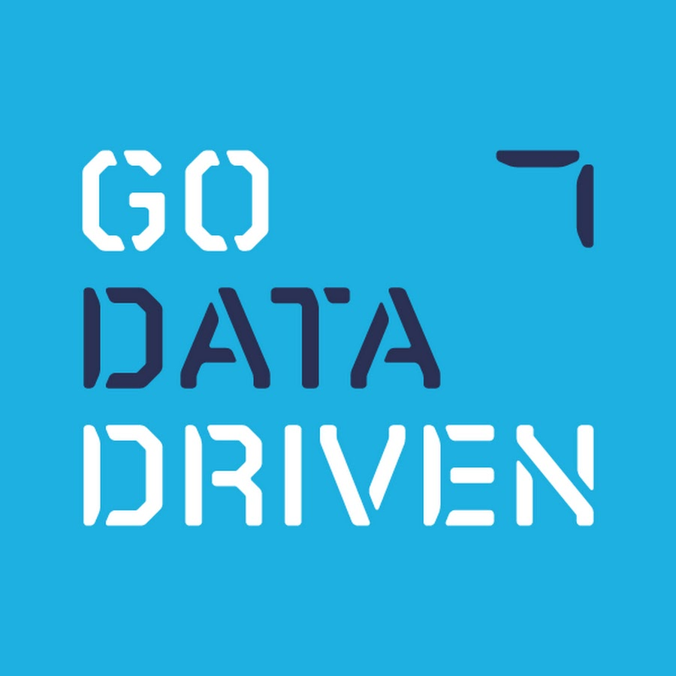


Slide 16
PyCon DE & PyData Berlin 2022
(Serious) Time for Time Series
It’s time to take time series seriously!
Notes:
Thank you - please do come and find us if you’re interested in GoDataDriven or any of our courses.
We’d also love to hear about you and what you do.
And finally, if you’re still interested, talk some more about time series!

